Slide 1
Iron: Can’t live without enough of it Can’t live with too much of it
Dr. Lawrence Wolfe
Associate Chief of Hematology
Deputy Chief of Operations
Cohen Children’s Medical Center
Professor of Pediatrics
Zucker Northwell School of Medicine
At Hofstra

Slide 2
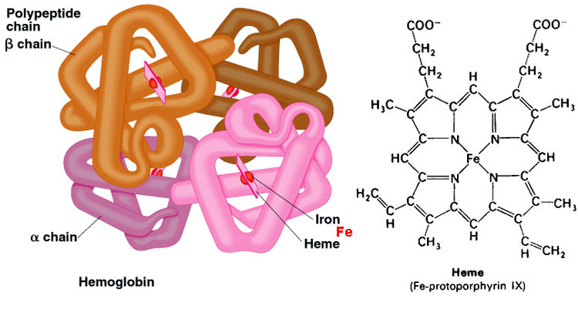

Slide 3
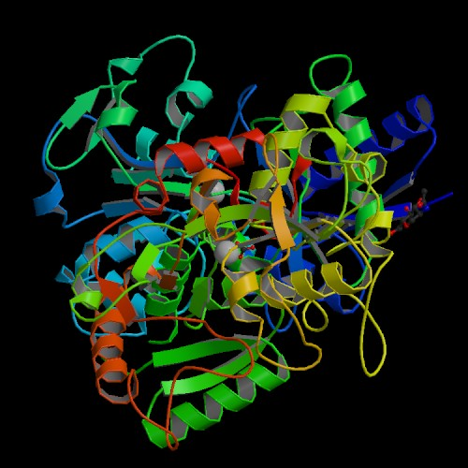
Transferrin

Slide 4
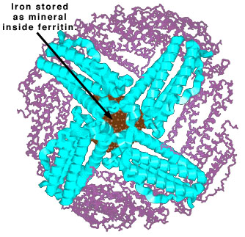
Ferritin

Slide 5
Iron plays an essential role in several metabolic processes
Heme iron compounds
Non-heme iron compounds
Hemoglobin, myoglobin
(oxygen transport)
NAD dehydrogenase
Cytochrome a,b,c (oxidative energy)
Xanthine oxidase
Cytochrome P450 (drug metabolism)
Ribonucleotide reductase
Catalase, peroxidase
(electron acceptor)
Succinate dehydrogenase
Notes:
Iron is one of the most common elements in nature and, as a transition metal, is essential for electron transport. It is required for the functioning of proteins involved in oxidative energy production, oxygen transport, mitochondrial respiration and inactivation of harmful oxygen radicals. Iron is also a rate-limiting factor in DNA synthesis.

Slide 6
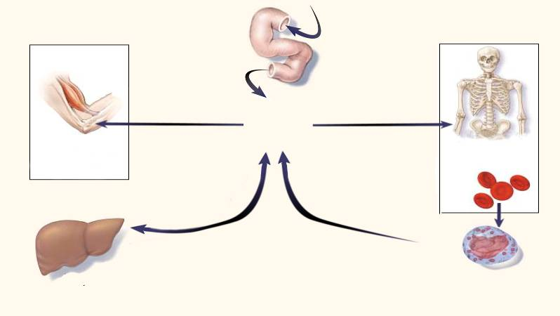
Normal distribution and storage of body iron
Dietary iron
Duodenum
Utilization
(average, 1–2 mg
Utilization
per day)
Transferrin
Functional
Transferrin
Muscle
iron pool
Bone
(myoglobin)
marrow
(300 mg)
Circulating
(300 mg)
Storage
erythrocytes
iron
(hemoglobin)
(1800 mg)
Sloughed mucosal cells
Desquamation/menstruation
Other blood loss
(average, 1–2 mg per day)
Liver
Reticuloendothelial
(1000 mg)
macrophages
Iron loss
(600 mg)
The human body has many mechanisms to absorb, transfer and store iron, but none to excrete it
Andrews NC. N Engl J Med 1999;341:1986–1995
Notes:
In a normal balanced state, 1–2 mg of iron enters and leaves the body every day. Dietary iron is absorbed by duodenal enterocytes and circulates in the plasma bound to transferrin, the main iron transport protein.¹
Most of the circulating iron is used by the bone marrow to generate hemoglobin for red blood cells, while around 10–15% is utilized by muscle fibers to generate myoglobin. Iron released by tissue breakdown is absorbed and recycled. Excess iron is stored by parenchymal cells in the liver and reticuloendothelial macrophages. Traces of iron are lost each day by sloughing of mucosal cells, loss of epithelial cells and any blood loss.¹
Since the human body has not evolved a mechanism to clear excess iron, disorders of iron balance, such as iron overload, are among the most common diseases in humans.
Reference
Andrews NC. N Engl J Med 1999;341:1986–1995.

Slide 7
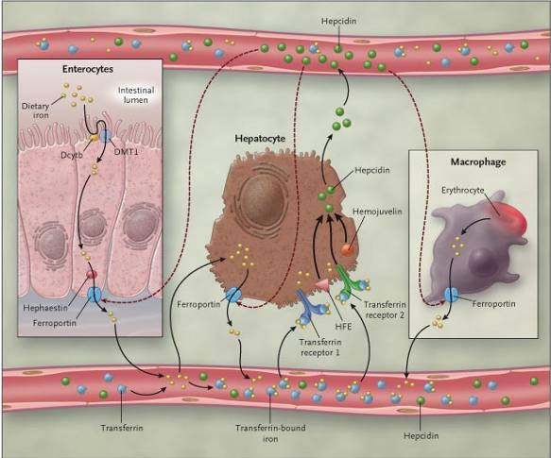
Regulation of cellular iron release (1)
Fleming RE et al. N Engl J Med 2005;352:1741–1744
Notes:
In the duodenal enterocyte, dietary iron is reduced to the ferrous state by duodenal ferric reductase (Dcytb), transported into the cell by divalent metal transporter 1 (DMT1), and released by way of ferroportin into the circulation.¹
Hephaestin facilitates enterocyte iron release. Hepatocytes take up iron from the circulation either as free iron or transferrin-bound iron (through transferrin receptor 1 and transferrin receptor 2). Transferrin receptor 2 may serve as a sensor of circulating transferrin-bound iron, thereby influencing expression of the iron regulatory hormone, hepcidin.
The hepcidin response is also modulated by HFE and hemojuvelin. Hepcidin is secreted into the circulation, where it down-regulates the ferroportin-mediated release of iron from enterocytes, macrophages and hepatocytes (dashed red lines).
Reference
Fleming RE et al. N Engl J Med 2005;352:1741–1744.

Slide 8
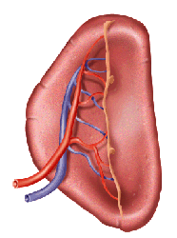
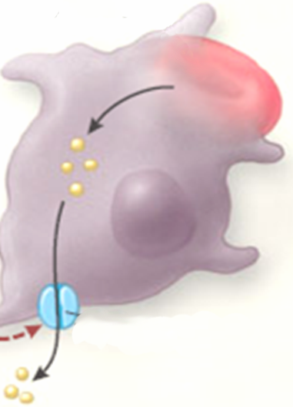
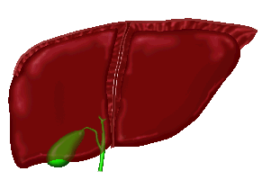
Specialized cells have mechanisms for exporting iron into plasma
Spleen
1% of the red cell mass is processed daily by spleen macrophages (10–15 mg Fe/day)
Macrophage
Erythrocyte
Iron released from processed hemoglobin is either exported back into plasma (via ferroportin) or stored as ferritin
_{Fe}
Fe²⁺
Ferritin
The released iron is absorbed by transferrin
Ferroportin
Ceruloplasmin
Ferroportin activity is regulated by hepcidin produced in the liver
Hepcidin
Fe³⁺
Fe²⁺
Transferrin
Courtesy of Professor IV Cabantchik
Notes:
Approximately 1% of red cells are processed daily by splenic macrophages (10–15 mg Fe/day). Iron released by this process is either stored within the macrophage as ferritin or transported back into the plasma by ferroportin.
Ferroportin mediates iron transfer with assistance from hephaestin.^{1,2} Ferroportin is specific for Fe²⁺ and functions unidirectionally. The transport of iron across the basolateral membrane may also be facilitated by the soluble plasma ferroxidase, ceruloplasmin, which is very similar to hephaestin.³
The ferroportin-mediated release of iron is regulated by hepcidin; during conditions of iron overload, for example, hepcidin internalizes and degrades ferroportin thus preventing iron entry into plasma. Once Fe²⁺ has crossed the basolateral membrane it is oxidized back to Fe³⁺ and is bound by transferrin.
References
Chen H et al. Blood 2004;103:3933–3939.
Donovan A et al. Nature 2000;403:776–781.
Hellman NE, Gitlin JD. Annu Rev Nutr 2002;22:439–458.

Slide 9
Dietary iron absorption
1–2 mg of iron are absorbed from the diet every day. The same amount is lost through cell sloughing and bleeding
Dietary heme and non-heme iron are taken up by duodenal enterocytes
Absorption of iron is finely controlled in response to body iron stores and iron needs
Notes:
Three regulatory mechanisms are thought to influence iron absorption –‘dietary’, ‘stores’ or ‘erythropoietin’ regulators.
A dual function compatible with both a ‘stores’ and an ‘erythropoietic’ regulator has been proposed for a recently discovered, 25 amino acid hepatic peptide called hepcidin. It is produced as a large precursor protein in the liver, is processed and secreted into the serum and then excreted in the urine.
Hepcidin regulates intestinal iron absorption and probably also affects the release of iron from hepatic stores and from macrophages involved in the recycling of iron from hemoglobin.¹
There is strong evidence in support of an important role for hepcidin dysregulation in the pathogenesis of iron overload disorders, and possibly in the etiology of the anemia of chronic disease.² For example:
Many cases of hemochromatosis may be due to hepcidin deficiency. Mice and humans with homozygous disruption of the HFE gene have inappropriately low expression of hepcidin mRNA in the liver, implicating HFE as a possible regulator of hepcidin
Since inflammation and IL-6 are strong stimuli for human hepcidin production, and hepcidin excretion is greatly increased during inflammation in humans, IL-6-induced hepcidin could be the mediator responsible for the iron restriction and inadequate erythropoiesis in anemia of inflammation.
The development of hepcidin analogues may therefore have future therapeutic applications.
References
Ganz T. Curr Opin Hematol 2004;11:251–254.
Hugman A. Clin Lab Haematol 2006;28:75–83.

Slide 10
Dietary iron absorption
Iron is then released into the plasma and loaded onto transferrin
Release of iron into plasma is controlled by hepcidin
Absorption of iron is finely controlled in response to body iron stores and iron needs
Notes:
Three regulatory mechanisms are thought to influence iron absorption –‘dietary’, ‘stores’ or ‘erythropoietin’ regulators.
A dual function compatible with both a ‘stores’ and an ‘erythropoietic’ regulator has been proposed for a recently discovered, 25 amino acid hepatic peptide called hepcidin. It is produced as a large precursor protein in the liver, is processed and secreted into the serum and then excreted in the urine.
Hepcidin regulates intestinal iron absorption and probably also affects the release of iron from hepatic stores and from macrophages involved in the recycling of iron from hemoglobin.¹
There is strong evidence in support of an important role for hepcidin dysregulation in the pathogenesis of iron overload disorders, and possibly in the etiology of the anemia of chronic disease.² For example:
Many cases of hemochromatosis may be due to hepcidin deficiency. Mice and humans with homozygous disruption of the HFE gene have inappropriately low expression of hepcidin mRNA in the liver, implicating HFE as a possible regulator of hepcidin
Since inflammation and IL-6 are strong stimuli for human hepcidin production, and hepcidin excretion is greatly increased during inflammation in humans, IL-6-induced hepcidin could be the mediator responsible for the iron restriction and inadequate erythropoiesis in anemia of inflammation.
The development of hepcidin analogues may therefore have future therapeutic applications.
References
Ganz T. Curr Opin Hematol 2004;11:251–254.
Hugman A. Clin Lab Haematol 2006;28:75–83.

Slide 11
The labile iron pool
Iron is taken up by cells from circulating transferrin via transferrin receptors TfR1 and TfR2
_{Fe}3+
Transferrin
Dcyb
PLASMA
_{Fe}2+
TfR1
TfR2
?
DMT1
?
Following various steps iron is delivered into the cytosol LIP of Fe2+
?
?
DMT1
LIP
Heme synthesis
Iron is used mostly by mitochondria for heme and iron-sulfur cluster synthesis
Endosome
_{Fe}2+
Fe-S cluster biogenesis
Mitochondria
Ferritin
Other iron utilization pathways
Excess iron is stored or withdrawn into ferritin
Courtesy of Professor IV Cabantchik
Most cells have no iron-release mechanisms
PLASMA
Notes:
Iron is taken up into cells from transferrin circulating in the plasma via transferrin receptors 1 and 2 (TfR1 and 2). Once inside the cell, iron is delivered to the cytosolic labile iron pool (LIP), which is a pool of chelatable and redox-active iron that is transitory and serves as a crossroads for cell iron metabolism.¹
Within the cells, iron in primarily used by mitochondria for the synthesis of heme and iron-sulfur clusters.
Any excess iron is stored in ferritin.
Reference
Kakhlon O & Cabantchik ZI. Free Radic Biol Med 2002;33:1037–1046.

Slide 12
Primary and secondary causes of iron overload
Primary (hereditary)
Resulting from a primary defect in the regulation of iron balance, eg, hereditary hemochromatosis
Secondary (acquired)
Caused by another condition or by its treatment
Ineffective erythropoiesis and anemias requiring repeated blood transfusion (eg DBA, thalassemia, sickle cell disease [SCD] and MDS)
Toxic ingestion
Feder JN et al. Nat Genet 1996;13:399–408; Porter JB. Br J Haematol 2001;115:239–252
Notes:
Generally, iron overload can be classified as primary (hereditary) or secondary (acquired), depending on whether it results from a primary defect in the regulation of iron balance or is secondary to other genetic or acquired disorders or their treatment.¹ Primary iron overload results from abnormally regulated iron absorption:²
Hereditary hemochromatosis is the best-known example and is caused by a missense mutation on the C282Y gene.³ This mutation results in the incorrect processing of regulatory receptors in the intestine⁴
Other mutations may also cause primary iron overload (eg, TfR2, ferroportin 1, ferritin H, hepcidin).
Secondary iron overload can result from the indirect effect of a condition or occur as a result of its treatment:¹
Ineffective erythropoiesis and anemias requiring repeated blood transfusions, such as β-thalassemia major, thalassemia intermedia, MDS and sickle cell disease (SCD)
Toxic ingestion, although this is very rare.
References
Piperno A. Haematologica 1998;83:447–455.
Porter JB. Br J Haematol 2001;115:239–252.
Feder JN et al. Nat Genet 1996;13:399–408.
Feder JN et al. J Biol Chem 1997;272:14025–14028.

Slide 13
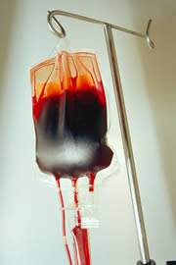
Transfusion therapy results in iron overload
1 blood unit contains 200 mg iron
A 60 kg patient with thalassemia receiving 45 units of blood annually has transfusional iron intake of 9 g iron/year
0.4 mg iron/kg body wt/day
In addition, up to 4 mg/day may be absorbed from the gut
Up to 1.5 g iron/year
Overload can occur after 10–20 transfusions
200–250 mg iron:
Whole blood: 0.47 mg iron/mL ‘Pure’ red cells: 1.16 mg iron/mL
Iron overload is an inevitable consequence of multiple blood transfusions
Porter JB. Br J Haematol 2001;115:239–252
Notes:
Iron overload, a cumulative toxicity, is an inevitable, potentially life-threatening consequence of multiple blood transfusions.
RBC transfusion is the mainstay of therapy for thalassemia. Transfusions are initiated when hemoglobin falls below 7 g/dL, or at higher levels to help resolve specific problems such as growth impairment, bone changes or progressive splenomegaly.
Transfusions are administered in sufficient quantity and frequency to achieve a hemoglobin level of at least 9.3 g/dL; this level partly suppresses the erythropoietic drive that is producing ineffective RBCs. A regimen that maintains the mean hemoglobin level above 10.5 to 11 g/dL reduces marrow expansion, arrests bone changes and minimizes splenomegaly. This leads to a reduction in plasma fluid volume, allowing an increase in relative concentration of hemoglobin. In children, growth may improve and more normal physical activity can be expected.^{1,2}
References
Thalassemia management. Parts I and II. Semin Hematol 1995;32:1996:33(1).
Olivieri NF & Brittenham GM. Blood 1997;89:739–761.

Slide 14
Normal distribution and turnover of body iron
Erythron
2 g
20–30 mg/day
20–30 mg/day
Parenchyma
0.3 g
Liver 1 g
Reticuloendothelial
macrophages
0.6 g
Transferrin
2–3 mg/day
1–2 mg/day
20–30 mg/day
Gut
Iron balance is achieved in the normal state
Hershko C et al. Ann NY Acad Sci 1998;850:191–201
Notes:
When iron homeostasis is in balance, iron is absorbed from the diet (gut) at a rate equivalent to 1–2 mg/day. After absorption from the duodenum, iron enters the plasma where it is complexed with transferrin.
Transferrin-bound iron in the plasma is the main pool supplying iron to the erythron, which cycles 20–30 mg of iron each day, as well as to hepatocytes and other parenchyma, which cycle around 10% of this amount.
Reference
Hershko C et al. Ann NY Acad Sci 1998;850:191–201.

Slide 15
Imbalance of distribution and turnover of body iron with transfusion therapy
Erythron
Transfusions
20–40 mg/day
NTBI
Parenchyma
Parenchyma
Reticuloendothelial
macrophages
Reticuloendothelial
macrophages
Transferrin
Transferrin
Gut
Iron balance is disturbed by blood transfusion because the body cannot remove the excess iron
NTBI, non-transferrin-bound iron
Hershko C et al. Ann NY Acad Sci 1998;850:191–201
Notes:
When iron homeostasis is in balance, iron is absorbed from the diet (gut) at a rate equivalent to 1–2 mg/day. After absorption from the duodenum, iron enters the plasma where it is complexed with transferrin.
Transferrin-bound iron in the plasma is the main pool supplying iron to the erythron, which cycles 20–30 mg of iron each day, as well as to hepatocytes and other parenchyma, which cycle around 10% of this amount. The erythron encompasses all circulating RBCs, their precursors and the tissues that produce them.
When transferrin becomes completely saturated during conditions of iron overload, iron circulates in the bloodstream as extracellular non-transferrin-bound iron (NTBI).
Reference
Hershko C et al. Ann NY Acad Sci 1998;850:191–201.

Slide 16
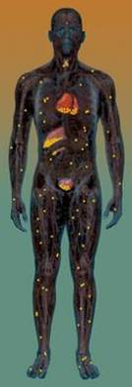
Iron overload leads to formation of NTBI
Transferrin saturation due to:
Frequent blood transfusions, or
Ineffective erythropoiesis leading to increased iron absorption
Subsequent formation of NTBI in plasma
Uncontrolled iron loading of organs
Pituitary
Parathyroid
Thyroid
Normal: no NTBI produced
Iron overload
100%
Heart
Fe
Liver
Fe
Pancreas
Fe
Fe
Gonads
Transferrin saturation
Fe
Fe
Fe
30%
Notes:
During conditions of normal iron balance, no NTBI is produced.
However, frequent blood transfusions cause a gradual increase in transferrin saturation, which leads to the presence of NTBI in the plasma. NTBI in the plasma eventually results in the uncontrolled loading of organs such as the liver, heart and endocrine glands.
Effective chelation therapy is designed to intervene at two points in this process. It chelates the free or labile iron in the blood to help prevent iron loading of organs. It also works to chelate and remove excess iron from within hepatic, myocardial and endocrine cells.

Slide 17
Iron Toxicity and Labile Iron
Iron Toxicity ≈ Tissue labile iron X Environmental factors X Genetics X
TIME
Iron bound to transferrin is Fe⁺³ and is not highly reactive.
Reactive Iron enters the ferritin shell as Fe⁺² but is converted to non-reactive Fe⁺³ by H-ferritin and is thus rendered non-toxic. So ferritin protects from toxic iron.
MRI detects big particles of non-toxic ferritin. Not the toxic form of iron.
The labile plasma iron (LPI) which is the toxic form of NTBI enters endocrine and cardiac cells through through transporters designed for calcium and zinc and thus this entry is not regulated.
Transferrin saturation > 50-70% reflects NTBI/LPI
Inflammation
Fe⁺² acts as a powerful amplifier of oxidant damage through formation of singlet oxygen and hydroxyl radicals
LPI / LCI
Heme

Slide 18
Toxic iron transport into tissue
Transfusion
Macrophage
RBC production
“Erythropoiesis”
NTBI / LPI increase rapidly when the transferrin saturation exceeds 60 -80%
Ceruloplasmin
ferritin
Fe⁺³
Fe
FPN
Fe
Hox1
Fe
Fe
Fe
Fe
Fe⁺²
Tf
HEP 
Fe
Fe
Fe
Tf
FPN
LCI
Labile cellular iron
Fe
Tf
Fe
HEP 
Fe
Heart
Active normal marrow uses 25 mg/day Fe to make red cells
Fe
Fe
Tf
Fe
Tf
Fe
LCC
Fe
Fe
Tf
Fe
Non-transferrin bound iron (NTBI)
Labile Plasma iron (LPI)
Fe
Fe
Fe
LCC
Fe
Fe
Tf
Fe
Fe
Tf
Fe
Fe
Fe
Fe
Fe
Fe
Fe
Tf
Tf
Fe
Fe
Fe
ferritin
Fe
100%
Fe
Fe
Fe
FPN
Fe
Fe
Fe
Pancreas and heart primarily load LPI and reflect the temporal sum of LPI exposure.
80%
Fe
Fe
Fe
HEP 
Fe
Tf
Fe
Tf
Fe
Fe
Fe
Fe
Fe
Transferrin saturation %
Tf
Fe
Tf
Fe
Fe
Fe
ferritin
ZIP14
Fe
30%
Tf-Fe loads liver via TfR
Liver
FPN
Fe
Fe
HEP 
Fe
ferritin
ferritin
Fe
Fe
Pancreas
Fe
FPN
Fe
FPN
HEP 
Normal
Iron overload
HEP 
Fe
Coates, TD, Free Radic Biol Med 2014 72:23-40
Notes:
18
Andrews NEJM 2004 about
1-2 mg per absorbed
Plasma Transferrin 3 mg
Muscle 300 mg
Hemoglobin 1800 mg
Liver parenchyma 1000 mg
RES 600 mg
Loss per day 1-2 mg

Slide 19
Uncontrolled uptake of labile iron leads to cell and organ damage
Storage iron
Non-transferrin iron
Uncontrolled uptake
Transferrin iron
Controlled uptake
Labile Iron
Functional iron
Free-radical generation
Organelle damage
Porter JB. Am J Hematol 2007;82:1136–1139
Notes:
LPI is taken up excessively by cells via an uncontrolled uptake mechanism (in the myocardium this is thought to be via calcium channels), leading to iron overload pathologies in the liver, heart and endocrine glands.
LPI is taken up initially by endocytic processes raising the cell LIP.¹ With sustained iron loading the metal also deposits as ferritin, which might eventually also transform into hemosiderin.
When LIP levels exceed the cell antioxidant capacity they evoke the formation of ROS that lead to cell damage by affecting lipids, proteins and nucleic acids.
Reference
Porter JB. Am J Hematol 2007;82:1136–1139.

Slide 20
Iron overload negatively affects organ function
Labile iron
Free radical generation
Lipid peroxidation
Organelle damage
TGF-β1
Lysosomal fragility
Collagen synthesis
Enzyme leakage
Cell death
Fibrosis
TGF, transforming growth factor
Cohen AR and Porter JB. In Disorders of Hemoglobin: Genetics, Pathophysiology, and Clinical Management, Steinberg MH et al. (Eds); 2001:979–1027
Notes:
Due to their high reactivity, hydroxyl radicals can cause oxidative damage affecting lipid, protein and DNA molecules. Lipid peroxidation may result in decomposition of lipid molecules with concomitant effects on organelle integrity, which can eventually lead to cell death.
Lipid peroxidation may also increase the production of transforming growth factor (TGF) β1, which is a multifunctional protein that regulates the growth and differentiation of a wide variety of cells, including collagen. Increased collagen synthesis via TGF-β1 ultimately leads to fibrosis.
Reference
Cohen AR and Porter JB. In Disorders of Hemoglobin: Genetics, Pathophysiology, and Clinical Management, Steinberg MH et al. (Eds); 2001:979–1027.

Slide 21
Excess iron is deposited in multiple organs, resulting in organ damage
Iron overload Capacity of serum transferrin to bind iron is exceeded
NTBI circulates in the plasma; some forms of NTBI (eg LPI) load tissues with excess iron
Excess iron promotes the generation of free hydroxyl radicals, propagators of oxygen-related tissue damage
Insoluble iron complexes are deposited in body tissues and end-organ toxicity occurs
Liver cirrhosis/ fibrosis/cancer
Diabetes mellitus
Endocrine disturbances→ growth failure
Cardiac failure
Infertility
Notes:
In patients who are iron-overloaded the capacity of serum transferrin to bind iron may be exceeded, which means that NTBI may circulate in the plasma.
This unbound iron, which is carried in the iron storage protein ferritin, can promote the generation of free hydroxyl radicals, which propagate oxygen-related tissue damage.
Additionally, insoluble iron complexes called hemosiderins may become deposited in body tissues causing toxicity and death.
Cardiac failure is a major, life-threatening complication of iron overload.¹ Iron deposition can cause myocarditis and cardiac fibrosis.² Myocardial fibrosis typically develops after a cumulative dose of approximately 100 units of blood.³ Symptoms of heart failure imply advanced disease and patients with iron-associated congestive heart failure or severe arrhythmias typically survive less than a year.³
There are a number of other possible complications of iron overload:
Excess iron deposition in the liver can lead to fibrosis/cirrhosis or cancer, and diabetes mellitus may occur as a result of β-cell destruction secondary to iron overload in the pancreas
Excess iron overload in the pituitary may cause growth failure due to hypogonadism and infertility due to reduced gonadotropin levels.
References
Borgna-Pignatti C et al. Ann NY Acad Sci 1998;850:227–231.
Ishizaka N et al. Circulation 2002;106:1840–1846.
Hershko C & Weatherall DJ. Crit Rev Clin Lab Sci 1988;26:303–345.

Slide 22
Organ systems susceptible to iron overload
Clinical sequelae of iron overload
Pituitary → impaired growth, infertility
Thyroid → hypoparathyroidism
Heart → cardiomyopathy, cardiac
Liver → hepatic cirrhosis
Pancreas → diabetes mellitus
Gonads → hypogonadism
Iron overload end-organ iron toxicities are inevitable in the absence of intervention therapy
Notes:
Excess iron is deposited in major organs, resulting in organ damage.
The organs that are at risk of damage due to iron overload include the liver, heart, pancreas, thyroid, pituitary gland and other endocrine organs.^{1,2}
The liver is the principal site for iron storage and has the largest capacity for excess iron storage. Collagen formation and portal fibrosis can occur within 2 years of the start of a transfusion regimen. When the liver capacity is exceeded, iron is deposited in other organs.^{1,2}
In the heart, iron collects in the cardiac muscle fiber cells, particularly in the ventricular wall and septum, the papillary muscles and the epicardium. Signs of myocardial damage due to iron overload present as arrythmia, cardiomegaly, heart failure and pericarditis.¹
In patients with β-thalassemia, iron loading of the anterior pituitary is primarily responsible for disrupted sexual maturation.² Many patients experience growth failure due to growth hormone deficiency or the defective synthesis of insulin-like growth factor.
Even with chelation therapy, diabetes mellitus is observed in approximately 5% of adults with β-thalassemia. Hyperinsulinemia often occurs with increased iron burden and progression of liver dysfunction due to iron damage. This is thought to be due to reduced hepatic insulin extraction, which leads to pancreatic β-cell exhaustion and reduced circulating insulin.²
Excess iron in patients with β-thalassemia can also damage the thyroid, parathyroid and adrenal glands.²
References
Gabutti V & Piga A. Acta Haematol 1996;95:26–36.
Olivieri NF. N Engl J Med 1999;341:99–107.

Slide 23
Post-mortem cardiac iron deposits correlate with blood transfusions in the pre-chelation era
100
131 transfused adult patients
101 leukemias
30 other anemias
80
60
Patients with cardiac iron (%)
40
20
0
0–25
26–50
51–75
76–100
101–200
201–300
Units of blood transfused
Cardiac iron deposition increases with the number of blood transfusions in unchelated patients
Buja LM & Roberts WC. Am J Med 1971;51:209–221
Notes:
This post-mortem study in 135 autopsy patients evaluated the etiologic factors related to myocardial iron deposition.¹ 131 patients had chronic anemia (101 with leukemia and 30 with other anemias) and had received blood transfusion therapy. The remaining four had idiopathic hemochromatosis.
The clinical records and electrocardiograms (ECGs) of each patient were reviewed, the number of blood transfusions received tabulated, and evidence of cardiac dysfunction recorded.
Nineteen of 135 patients (14.1%) had cardiac iron deposits (CID). Ventricular CID were grossly visible in nine patients and microscopically visible in 10. Atrial CID were extensive in six patients but minimal in the other 13. Iron deposits in the conduction system were rare. Every patient who had iron in the myocardium also had iron in other organs and tissues.
This slide shows the percentage of patients with CID in the 131 patients with anemia who received blood transfusions. The proportion of patients with cardiac iron deposition was generally shown to increase in line with the amount of blood transfused, demonstrating the importance of transfusion in the development of iron overload.
Each anemic patient who received more than 100 units of blood had extensive CID unless chronic bleeding diatheses coexisted. Each patient with anemia with extensive CID who received less than 100 units of blood had hepatic cirrhosis.
Reference
Buja LM & Roberts WC. Am J Med 1971;51:209–221.

Slide 24
Repeated transfusions lead to iron overload in SCD
30
25
20
R=0.795
Liver iron (mg Fe/g dw)
15
10
5
0
0
20
40
60
80
100
120
140
160
Transfusion duration (months)
There is a significant correlation between the duration of transfusions and liver iron in patients with SCD
Harmatz P et al. Blood 2000;96:76–79
Notes:
Blood transfusions are indicated in SCD for the treatment of acute/episodic and chronic complications. The aim of transfusion therapy is to increase hemoglobin and therefore the oxygen-carrying capacity of the blood and to reduce the proportion of the sickle cells in the circulation.
Acute/episodic indications for transfusion therapy include: anemia, splenic sequestration, severe aplastic crises, stroke, acute chest syndrome and multiple organ failure.
Chronic indications include heart failure, prophylaxis against recurrent stroke, stroke prevention where transcranial Doppler velocities are abnormal, chronic pulmonary hypertension, severe vaso-occlusive crises and chronic pain.
The STOP trials demonstrated that transfusions are effective in preventing stroke. There has, as a result, been an increase in patients with SCD receiving chronic transfusions and concerns that such patients may develop iron overload. An increase in serum ferritin levels in the STOP trial participants suggested that these patients may have developed iron overload.
The objective of this study was to assess the degree of iron overload in patients with SCD who receive chronic transfusion therapy and to determine whether such patients suffer significant liver injury.¹
The study evaluated 20 patients with hemoglobin SS on chronic transfusion therapy. The mean duration of transfusion therapy prior to biopsy was 57±35 months (range 12–146). The mean age of the patients was 13.5 years (range 2–31).
As shown on the slide, the amount of iron in the liver was shown to correlate significantly with the duration of transfusions (R=0.795).
Reference
Harmatz P et al. Blood 2000;96:76–79.

Slide 25
Liver with iron overload
Normal liver

Slide 26
Pancreas with massive iron overload
Normal pancreas

Slide 27
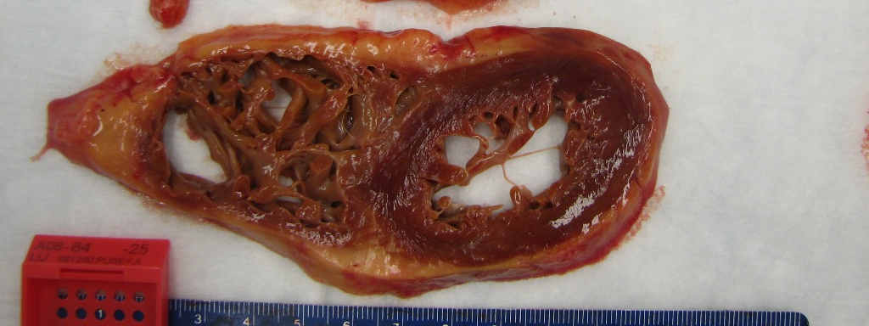
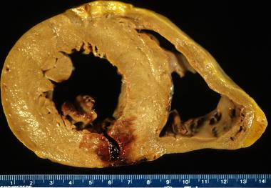
Dilated cardiomyopathy with iron overload

Slide 28
Iron loading through unregulated NTBI/LPI mechanisms is greater if RBC production is ineffective or turned off as it is in DBA
Disorders with ineffective erythropoiesis (black) have greater exposure to free iron
R2* = iron
Total iron loading is independent of marrow activity
Coates, TD, Free Radic Biol Med 2014 (Apr 12 epub)
Berdoukas, V. et al American Journal of Hematology 2013

Slide 29
Thresholds for parameters used to evaluate iron overload
 |  | Iron-overloaded state
Parameter | Normal | Mild | Moderate | Severe
LIC, mg Fe/g dw | <1.2 | 3–7 | >7 | >15
Serum ferritin, ng/mL | <300 | >100 to <2500 |  | >2500
Transferrin saturation, % | 20–50 | >50
Myocardial T2*, ms | >20 | 8–20 |  | <8
Alanine aminotransferase (ALT), U/L | <250 | >250
LPI, μM | 0–0.4 | >0.4
Increased risk of complications/cardiac disease
Notes:
Various parameters can be used to assess iron overload, including LIC, serum ferritin, transferrin saturation, liver enzyme levels (eg alanine aminotransferase [ALT]), LPI levels and cardiac T2*.
The slide summarizes the normal levels of these parameters and provides an indication of levels in an iron-overloaded state.
For LIC, levels >7 mg Fe/g dw indicate an increased risk of complications; at levels >15 mg Fe/g dw there is a heightened risk of cardiac disease and death.
Normal serum ferritin levels differ for males and females: <300 ng/mL is within the limit of normal for a male; <150 ng/mL defines the limit for a female. Mild–moderate iron overload is indicated by serum ferritin levels 300–2500 ng/mL. Levels >2500 ng/mL are associated with an increased risk of cardiac disease.
The amount of transferrin that is bound to iron (ie saturated) in a normal individual is between 20–50%. Once transferrin saturation exceeds 50%, this indicates an iron-overloaded state.
Normal T2* values are considered to be >20 ms, while values below are ‘abnormal’; a T2* <10 ms suggests a severely iron-overloaded state.
Normal alanine aminotransferase levels are classified as <250 U/L.
The limit of assay for LPI or the background level found in sera from normal patients is 0.4 μM. Anything above that level is indicative of iron overload.
A variety of methods are available for measuring LPI. Further evaluation of these techniques is required to validate the methodology and determine the relationship to patient prognosis. Currently these measures are research tools to demonstrate proof of concept; clinical significance may become clearer in the future.

Slide 30
Measuring LIC by liver biopsy
Advantages | Disadvantages
Direct measurement of LIC | Invasive; painful; potentially serious complications, eg bleeding
Validated reference standard | Risk of sampling error, especially in patients with cirrhosis
Quantitative, specific and sensitive | Inadequate standardization between laboratories
Allows for measurement of non-heme storage iron | Difficult to follow-up
Provides information on liver histology/pathology
Positive correlation with morbidity and mortality
Notes:
Liver biopsy is the validated standard method for assessing LIC. It provides a direct measurement of LIC, being quantitative, specific and sensitive, and has been shown to be positively correlated with morbidity and mortality.
However, the technique is invasive and can be painful, carrying a risk of potentially serious complications such as bleeding. In addition, there is a significant risk of sampling error and there is currently poor standardization between laboratories.

Slide 31
Liver iron concentration predicts total body iron stores
Body iron (mg/kg) = 10.6 x LIC (mg Fe/g dry wt)
PRBC (ml) x 1.08 ≅ Δ LIC (mg / g dw)
10.6 x wt (kg)
300
700 cc in a 70 kg patient raises LIC by 1.02 mg
250
R = 0.98
200
Total body iron stores (mg/kg)
150
100
Stores calculated by quantitative phlebotomy
LIC measured from biopsy samples in 25 patients
50
0
0
5
10
15
20
25
LIC (mg Fe/g dry wt)
Angelucci E, et al. N Engl J Med. 2000;343:327-31.

Slide 32
LIC and liver prognosis
The liver is the primary site of iron storage in the body
Threshold LIC levels (mg Fe/g dw)
1.2
7
15
Mild iron overload
Moderate iron overload
Severe iron overload
Normal
Increased risk of liver fibrosis
Progression of liver fibrosis
Deranged ALT
Jensen PD et al. Blood 2003;101:4632–4639; Angelucci E et al. Blood 2002;100:17–21
Notes:
The liver is the primary site of iron storage in the body.
In patients who are not transfusion-dependent and who do not have a hemochromatosis mutation, normal LICs are usually <1.2 mg Fe/g dw.
There is an increased risk of iron-induced complications if LIC is >7 mg Fe/g dw:
Hepatic fibrosis
Diabetes mellitus.
Greatly increased risk of cardiac disease and death if LIC >15 mg Fe/g dw.
Patients with β-thalassemia major require regular blood transfusions, often starting at 2–3 years old:
Hepatic iron overload becomes apparent after approximately 10 to 12 transfusions
Without therapy, iron overload is fatal by age 20
Chelation therapy is required to prevent increased risk of complications.
Hemochromatosis:
Phlebotomy may be effective for lowering iron concentrations
Untreated homozygotes reach the threshold for cardiotoxicity at age ~40.
References
Jensen PD et al. Blood 2003;101:4632–4639.
Angelucci E et al. Blood 2002;100:17–21.

Slide 33
Methods used to assess iron overload
Transferrin saturation
Serum ferritin
LIC
Iron distribution (eg cardiac iron and pancreatic iron)
Notes:
There are a number of methods available for evaluating body iron burden.
These include:
Standard measures such as LIC or serum ferritin levels
Specialist measures such as the evaluation of cardiac iron levels or LPI.

Slide 34
Measuring and interpreting serum ferritin
Advantages | Disadvantages
Easy to assess | Indirect measurement of iron burden
Inexpensive | Fluctuates in response to inflammation, abnormal liver function, ascorbate deficiencies
Repeat serial measures are useful for monitoring chelation therapy | Individual measures may not provide reliable indication of iron levels and response to chelation therapy
Positive correlation with morbidity and mortality
Allows longitudinal follow-up of patients
Serial measurement of serum ferritin is a simple, reliable, indirect measure of total body iron
Notes:
The measurement of serum ferritin levels is an indirect measure of body iron. Long-term serial assessment is useful for monitoring chelation therapy.
The predictive value of serum ferritin for major complications of iron overload varies according to the type and severity of underlying anemia and the mechanism of iron loading.

Slide 35
Ferritin and serum ferritin
Ferritin is primarily an intracellular protein that:
Stores iron in a form readily accessible to cells
Releases it in a controlled fashion
The molecule is shaped like a hollow sphere that stores ferric (Fe³⁺) iron in its central cavity
The storage capacity of ferritin is approximately 4500 Fe³⁺ ions per molecule
Ferritin is found in all tissues but primarily in the liver, spleen and bone marrow
A small amount is also found in the blood as serum ferritin
Serum ferritin >1000 ng/mL is a marker of excess body iron
Harrison PM & Arosio P. Biochim Biophys Acta 1996;1275:161–203
Notes:
As free iron is toxic to cells, the body has a number of protective mechanisms with which to bind iron in various tissue compartments. Within cells, iron is stored complexed to proteins called ferritin or hemosiderin.
Ferritin is primarily an intracellular protein that stores iron in a form readily accessible to cells and releases it in a controlled fashion. Ferritin is shaped like a hollow sphere, inside which iron is stored in the ferric (Fe³⁺) state. Each ferritin molecule can store approximately 4500 Fe³⁺ ions.
Ferritin can act as a ‘buffer’ against iron storage problems, eg, by releasing more if the body is iron deficient, or, to some extent by storing excess iron if the blood and body tissues are iron-overloaded.
To release iron when required (eg in a state of iron deficiency), the iron must be reduced from the Fe³⁺ to the ferrous (Fe²⁺) state. Iron then leaves the ferritin complex through channels in the spherical structure.
Ferritin is primarily found in the liver, spleen and bone marrow; that found in the blood is called serum ferritin.
It is not known how serum ferritin is produced. One possible explanation is that it is ‘spillover’ from cells when intracellular iron levels are high.
Under steady-state conditions, the serum ferritin level correlates with total body iron stores. Thus, the measurement of serum ferritin is the most convenient laboratory test available to estimate body iron stores.
Ferritin is also an acute-phase reactant, so can be naturally elevated during the course of disease. Acute and chronic inflammation and infections influence its levels; ascorbate levels and increased erythropoiesis can also alter circulating ferritin levels.
Reference
1. Harrison PM & Arosio P. Biochim Biophys Acta 1996;1275:161–203.

Slide 36
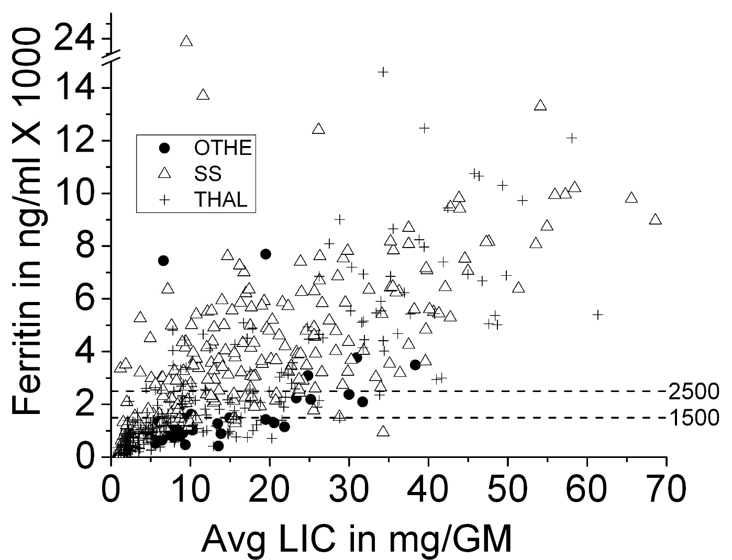
Relation of serum ferritin to LIC in populations of iron loaded patients
527 observations in 117 patients
r = 0.8 (p<0.0001)
Puliyel M, et al. 2014; Am. J. Hematology 89(4) 391.
Notes:
While there is a correlation in populations of patients the utility of ferritin to monitor fe in individual patients is limited by the extreme variability of ferritin

Slide 37
Relationship between serum ferritin and myocardial iron
40
Myocardial iron (µmol/g)
35
Patient group (n=14)
11 MDS
1 Diamond-Blackfan anemia (DBA)
1 chronic hemolysis of unknown origin
1 acute myeloid leukemia (AML) in complete remission
30
25
20
15
10
5
0
100
1000
10000
Serum ferritin (ng/mL)
Cardiac iron loading associated with serum ferritin levels >1800 ng/mL
Jensen PD et al. Blood 2003;101:4632–4639
Notes:
This study used the spin echo MRI technique for the repeated estimation of myocardial iron levels during chelation therapy with DFO in 14 adult non-thalassemic patients (MDS, n=11; DBA, n=1; chronic hemolysis of unknown etiology, n=1; AML, n=1) with transfusional iron overload. The investigators evaluated the repeatability of the technique and the relationship between the myocardial iron estimates and iron status.
Of the patients with LIC below 350 μmol/g, all but one had myocardial iron within normal (≤8 μmol/g) or nearly normal levels. When liver iron levels reached a threshold of 350 μmol/g, iron deposition became evident in the myocardium. At the same time, there was a proportional increase in UIE, indicating raised levels of labile iron. Serum ferritin levels of >1800 ng/mL were also associated with myocardial deposition.
Myocardial iron estimates at treatment start were closely related to UIE and serum ferritin concentration, but less so to LIC.
The results suggest that excess iron is deposited in the myocardium if a critical LIC of 350 μmol/g is exceeded. This causes expansion of the chelatable iron pool reflected by increased levels of UIE. The size of the chelatable (labile) iron pool therefore appears pivotal for the development of myocardial siderosis.
Reference
Jensen PD et al. Blood 2003;101:4632–4639.

Slide 38
Measuring LIC with MRI
Advantages | Disadvantages
Non-invasive | Indirect measurement of LIC
Assesses iron content throughout the liver | Requires magnetic resonance imager with dedicated imaging method
Increasingly widely available worldwide | Children under the age of 7 years require a general anesthetic
Status of liver and heart can be assessed in parallel
Validated relationship with LIC
Allows longitudinal patient follow-up
Notes:
Different MRI techniques are useful for measuring iron levels in both the heart and liver.
MRI can produce images in two different ways. Both methods can be used to estimate iron:
Gradient echo imaging produces images for calculating T2* and R2*
Spin echo imaging produces images for calculating T2 and R2.

Slide 39
Relationship between R2* MRI and liver biopsy (3)
2000
Patients
Controls
Fit
R2* increases linearly with iron
Calibration independently validated in 23 biopsies
1800
1600
1400
1200
R2* (Hz)
1000
800
600
400
R=0.97
200
0
0
10
20
30
40
50
60
Biopsy LIC (mg/g dry tissue)
Paired R2* measurements demonstrated no mean difference, making MRI suitable for longitudinal examination
Wood JC et al. Blood 2005;106:1460–1465
Notes:
In the study by Wood et al. R2* correlated closely with LIC.
Reference
Wood JC et al. Blood 2005;106:1460–1465.

Slide 40
MRI measurement of iron
MRI measurements of iron required special software. Most commonly done on 1.5 T machines. Iron quantitation on new, higher power 3T magnets is not routinely available.
Liver iron levels:
Normal liver iron is 0.8 to 1.5 mg per gram of liver
less than 3.5 gram is acceptable for clinical control
over 40 mg/g are not reliable measurement
Cardiac iron:
T2* > 30 ms is normal, > 20 ms is the old “normal”
T2* < 10 is significant iron loading and < 8 ms is the danger zone
Pancreas and Pituitary iron: are not commonly available
R2, R2*, T2, T2* are the numbers from MRI that measure iron
R2* = 1000/T2* Low R2/R2* is good, High T2/T2* is good
Notes:
00

Slide 41
Iron burden is clinically significant across all transfusion-dependent anemias
Mean baseline liver iron concentration (LIC) in deferasirox trials
(measure of TOTAL body iron)
25
Increased mortality
20
>15
15
Increased organ dysfunction
LIC (mg Fe/g dw)
7–15
10
5
Clinical concern
>2–7
0
Normal
<1.2
Thalassemia
Other anemias
SCD
Patients were not achieving iron balance with current chelation regimens
Cappellini MD et al. Blood 2006;107:3455–3462; Porter J et al. Eur J Haematol 2008;80:168–176; Vichinsky E et al. Br J Haematol 2007;136:501–508
Studies 107, 108 and 109
Notes:
Liver iron concentration (LIC) is the accepted surrogate of total body iron and is the most robust measure of chelator efficacy in the clinical trial setting:
Normal LIC: ≤1.2 mg Fe/g dw
Clinical concern: 2–7 mg Fe/g dw
Increased risk of morbidity: 7–15 mg Fe/g dw
Increased mortality: ≥15 mg Fe/g dw (also shown at serum ferritin values >2500 ng/mL).
This slide demonstrates that the mean baseline LICs upon entry into deferasirox clinical studies were in the ‘extreme risk’ category.^{1–3} It is important to note that patients with thalassemia had the lowest LIC, which may be due to the high number of very young children who have received less total blood in their lifetime.
It is clear that there is an unmet medical need and that a more effective chelator is required – this was the incentive for development of deferasirox.
References
Cappellini MD et al. Blood 2006;107:3455–3462.
Porter J et al. Eur J Haematol 2008;80:168–176.
Vichinsky E et al. Br J Haematol 2007;136:501–508.

Slide 42
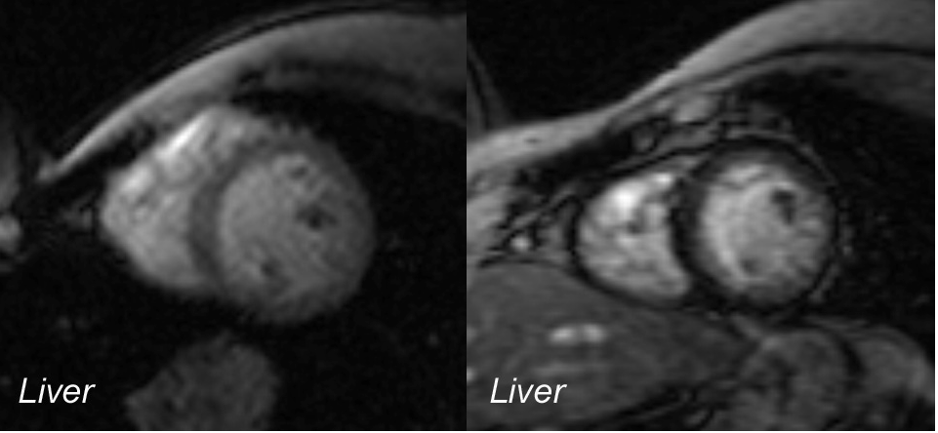
Liver iron does not directly correlate with cardiac iron
A
B
Myocardium
Myocardium
Black means high iron. In the MRI between A and B, the cardiac iron was high and the patient became adherent to chelation. Panel B shows the liver clears before the heart. (image courtesy of Dr J Wood)
You can remove 50% of the iron from Liver in 4 to 6 months
It takes 17 months to remove half the iron from the heart.
Coates, TD, Free Radic Biol Med 2014 (Apr 12 epub)

Slide 43
Measuring cardiac iron with MRI
Advantages | Disadvantages
Rapidly assesses iron content in the septum of heart | Indirect measurement of cardiac iron
Relative iron burden can be estimated reproducibly | Requires magnetic resonance imager with dedicated imaging method
Functional parameters can be examined concurrently | Cardiac methodologies remain to be standardized
Iron status of liver and heart can be assessed in parallel
Allows longitudinal follow-up
MRI is a non-validated method to rapidly and effectively assess cardiac iron
Notes:
Different MRI techniques are useful for measuring iron levels in both the heart and liver.
MRI can produce images in two different ways. Both methods can be used to estimate iron:
Gradient echo imaging produces images for calculating T2* and R2*. These are the same parameters but R2*=1000/T2*. For example: T2* of 20 ms is an R2* of 50 Hz. A T2* of 5 is an R2* of 200 Hz. Conversely, T2*=1000/R2*
Spin echo imaging produces images for calculating T2 and R2.

Slide 44
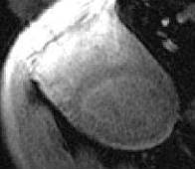
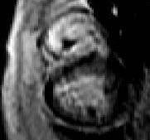
T2* MRI: Emerging new standard for cardiac iron
90
80
70
60
50
LVEF (%)
40
Cardiac T2* value of 37 ms in a normal heart
30
20
10
0
0
10
20
30
40
50
60
70
80
90
100
Heart T2* (ms)
Myocardial T2* values <20 ms are associated with progressive and significant decline in LVEF
Cardiac T2* value of 4 ms in a significantly iron-overloaded heart
LVEF, left ventricular ejection fraction
Anderson LJ et al. Eur Heart J 2001;22:2171–2179
Notes:
The T2* MRI is becoming the new standard for measuring cardiac iron levels.
Relationship between myocardial T2* values and LVEF:
Below a myocardial T2* of 20 ms, there was a progressive and significant decline in LVEF (R=0·61, P<0·0001).
If there is no iron present in the heart, the incidence of cardiomyopathy is comparable to the normal population. In general, the lower the T2*, the higher the risk of cardiac dysfunction. However, some patients with iron overload also have high T2* and therefore apparently no cardiac problems.
In the figure, the broken lines represent the normal reference ranges for myocardial T2* and parameters of cardiac function.
Reference
Anderson LJ et al. Eur Heart J 2001;22:2171–2179.

Slide 45
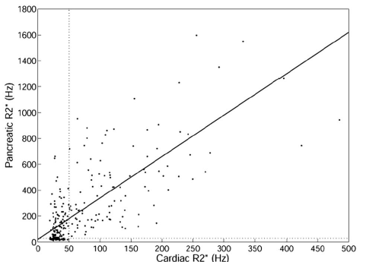
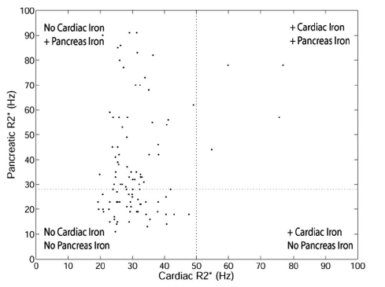
Pancreatic Fe predicts cardiac Fe
Noetzli LJ, et al . Blood. 2009; 114:4021-26.
Notes:
we examined pancreatic and cardiac iron in 131 thalassemia major patients over a 4-year period. Cardiac iron (R2* > 50 Hz) was detected in 37.7% of patients and pancreatic iron(R2* > 28 Hz) in 80.4% of patients. Pancreatic and cardiac R2* were correlated (r2 0.52), with significant pancreatic iron occurring nearly a decade earlier than cardiac iron. A pancreatic R2* less than 100 Hz was a powerful negative predictor of cardiac iron, and pancreatic R2* more than 100 Hz had a positive predictive value of more than 60%.

Slide 46
What is chelation therapy?
Toxic
Chelator
Chelator
Metal
Metal
Excretion
Notes:
Chelation therapy involves the use of a drug that is capable of binding with a metal in the body to form what is called a chelate. By doing so, the metal loses its toxic effect, or physiological activity, and is then more readily removed from the body.
Chelation therapy is generally reserved for the forms of iron overload in which phlebotomy cannot mobilize iron stores adequately or cannot be tolerated because of concurrent anemia.

Slide 47
Goals of iron chelation
Bind circulating reactive iron
Protect from the toxic effects of reactive iron
Remove excess iron from the tissues

Slide 48
General Principles of chelation
We want adequate levels of chelator circulating at all times to bind the NTBI/LPI and prevent its entry into endocrine organs and the heart.
This is especially important if there is already some cardiac iron, because presence of cardiac ion makes the rate of loading faster. Any time there is no chelator, iron can rapidly load the heart.
Chelator combinations should be adjusted to maximize the likelihood that they are taken, even if this means not strictly following dosing guidelines.
Deferiprone can cause marrow failure in patients with DBA. Even though it is a great chelator, it should not be used for routine chelation. It is the drug of choice in the face of symptomatic heart failure and arrhythmia and may be used in DBA until the cardiac situation is stabilized.

Slide 49
Chelation
There are currently three approved iron chelators
They all work
They all have the same fatal flaw: They do not work if you do not take them.
The biggest barrier to effect iron removal is failure to adhere to chelation treatment.

Slide 50
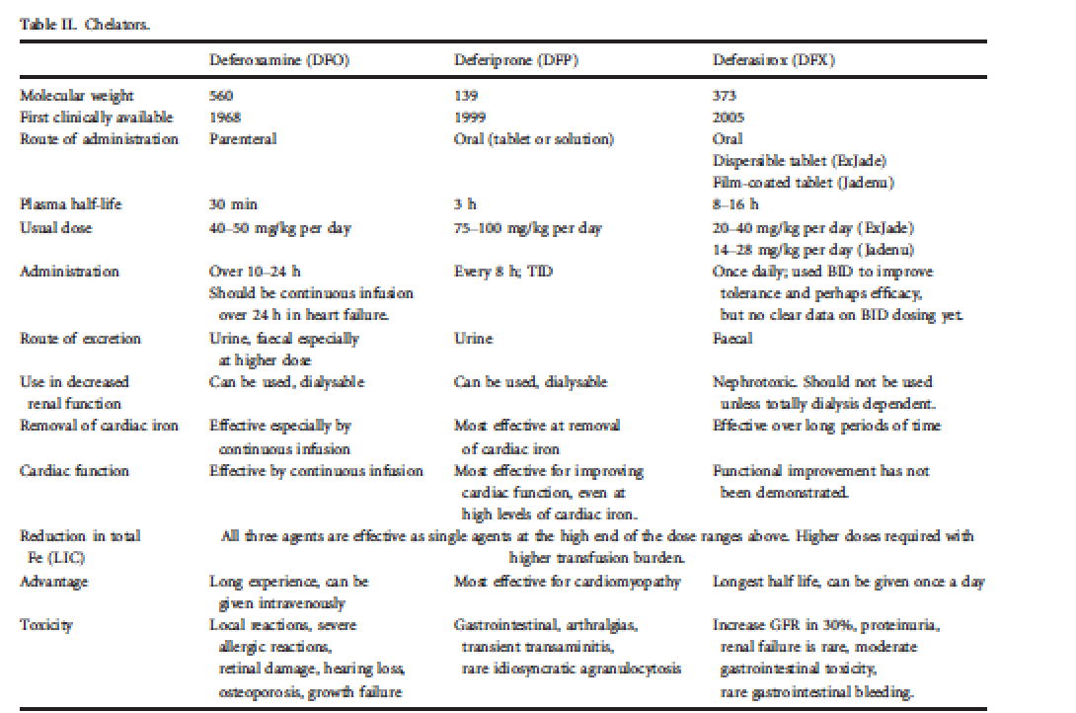
Iron chelators
Use DFP with great care in DBA
Coates, TD 2017 BJH 177(5): 703

Slide 51
Comparison of chelators
Property | DFO | Deferiprone | Deferasirox
Usual dose (mg/kg/day) | 25–60 | 75–100 | 20–30
Route | Sc, iv (8–12 hours, 5 days/week) | Oral 3 times daily | Oral Once daily
Half-life | 20–30 minutes | 3–4 hours | 8–16 hours
Excretion | Urinary, fecal | Urinary | Fecal
Main adverse effects in prescribing information | Local reactions, ophthalmologic, auditory, growth retardation, allergic | Gastrointestinal disturbances, agranulocytosis/ neutropenia, arthralgia, elevated liver enzymes | Gastrointestinal disturbances, rash, renal impairment, hepatic impairment, ophthalmologic, auditory
Status | Licensed | Licensed outside US/Canada | Licensed
Notes:
This slide covers some of the important characteristics of DFO, deferiprone and deferasirox, a once-daily oral chelator.
Deferiprone is licensed outside North America. The approved indication in Europe is for iron overload in patients with thalassemia major when DFO therapy is contraindicated or inadequate.
Deferiprone and deferasirox are administered orally, which eliminates a major hindrance to chelation therapy with DFO – the necessity for delivering the agent subcutaneously or intravenously over an extended period of time using specialized pumps.
Deferasirox also has a long half-life which allows for once-daily dosing versus deferiprone’s 3 times a day. Deferasirox has also been shown to be generally well tolerated in adults and pediatric patients as young as 2 years and across a range of transfusion-dependent anemias, including β-thalassemia, MDS, SCD and DBA.

Slide 52
Guidelines for starting treatment of iron overload in patients with β-thalassemia major
Thalassaemia International Federation guidelines for the clinical management of thalassemia (2008)¹ recommend that chelation therapy is considered when patients:
Have received 10–20 transfusion episodes OR Have a serum ferritin level of >1000 ng/mL
Italian Society of Hematology practice guidelines for the management of iron overload in patients with thalassemia (2008) ² recommend that chelation therapy is considered when patients:
Have received >10 transfusion episodes OR Have a serum ferritin level of >1000 ng/mL
¹Thalassaemia International Federation. Guidelines for the clinical management of thalassemia, 2nd Edition revised 2008; ²Angelucci E et al. Haematologica 2008;93:741–752
Notes:
In thalassemia major, guidelines recommend initiating chelation therapy as soon as transfusions have deposited enough iron to cause tissue damage. Current practice is to start after first 10–20 transfusions or when the serum ferritin level is >1000 ng/mL.
If chelation therapy with DFO is commenced in pediatric patients before 3 years of age, monitoring of growth and bone development and use of a reduced DFO dose is recommended.
Reference
Thalassaemia International Federation. Guidelines for the clinical management of thalassemia, 2nd Edition revised 2008.

Slide 53
Starting Parameters for Routine Chelation for patients with DBA Receiving Ongoing Transfusion*
Start chelation after age 2 with Deferasirox at 20 mg/kg/day (Jadenu 14 mg/kg/day in young children who can take pills) to determine tolerability and efficacy.
Increase to Deferasirox 40 mg/kg/day (Jadenu 28 mg/kg/day) if ferritin > 1000 ng/ml with no significant downtrend after 3-4 months of first dosing schedule. (most chronically transfused patients need 20-40 mg/kg/day of Exjade or 21-28 mg/kg/day of Jadenu) – the chelation may increase the ferritin for 2-3 months after starting but should eventually start downtrending
Use Deferoxamine 35-50 mg/kg/day subQ 5-7 days/week (depending on starting ferritin level) if intolerance to Deferasirox.
*If patients receiving intermittent transfusion, more careful analysis required to avoid chelator toxicity

Slide 54
High cardiac iron is very dangerous
Cardiac T2* less than 6 ms means very very high heart iron
High risk of heart failure
High risk of heart rhythm disturbances including sudden death
High cardiac iron and presence of arrhythmia or heart failure is a medical emergency.
Very few heart specialists know how to manage this.
They do not know that even very severe cases can almost always be reversed with proter treatment.
You need to speak to an experience thalassemia doctor immediately.
If there is no heart failure or arrhythmia, the iron overload can always be reversed using current treatments.
Heart failure from iron overload can be reversed 99% of the time. Most cardiologists do not know this!

Slide 55
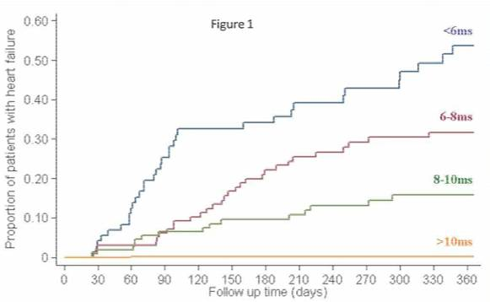
Cardiac T2* predicts Heart Failure in thalassemia
Low T2*, especially if there is decreased ventricular contraction or arrhythmia is a huge danger sign
Kirk P, et al, Circulation, 2009

Slide 56
Symptomatic heart failure due to iron is a medical emergency
Iron cardiomyopathy is almost 100% reversible if treated soon enough to prevent death.
Very few cardiologists or hematologists know how to treat this

Slide 57
Transient Effect of Deferoxamine on NTBI
7
So it is really important to have chelator circulating as much of the time as possible because it protects from the damage from iron.
6
5
4
Concentration (µM)
DFO
3
2
NTBI
1
0
-1
-6
0
6
12
18
24
30
36
42
48
54
Hours
DFO = deferoxamine; NTBI = non-transferrin-bound iron.
Porter et al. Blood. 1996;88:705.
Notes:
Porter et al¹ studied the kinetics of non-transferrin-bound iron (NTBI) in the plasma of transfusion-dependent patients with thalassemia major (TM) and patients with thalassemia intermedia (TI) during treatment with deferoxamine (DFO).
Adult patients at University College Hospital in London (TM, n=17; TI, n=8)
Patients with TM were receiving regular transfusions of 2 to 4 units of blood every 3 to 4 weeks to maintain hemoglobin ≥10 g/dL.
Patients received no DFO or ascorbate supplements within 72 hours of study initiation.
Healthy adults (n=11) served as reference controls (no DFO treatment).
Methods
Patients with TM and those with TI received DFO (50 or 100 mg/kg/d) via 48-hour continuous IV infusion.
Heparinized plasma samples were taken for pharmacokinetic (PK) analysis of DFO and NTBI levels (performed by high-performance liquid chromatography [HPLC]); 24-hour urine was collected for estimation of iron excretion, and serum samples were taken for measurement of serum iron, total iron binding capacity, ferritin, and hemoglobin levels.
NTBI values are “negative” when unsaturated transferrin binds iron from the sample buffer.
Results
No NTBI was detectable in healthy controls.
NTBI was detectable at baseline in 24 of the 25 patients with TI or TM and was significantly higher for patients with TI, who do not receive regular chelation (P=0.026).
For TI, NTBI levels were 4.52 ± 0.53 μmol/L.
For TM, NTBI levels were 2.92 ± 0.29 μmol/L.
NTBI levels decreased below detectable levels during DFO infusion but persisted in some patients, suggesting the presence of slowly chelated or DFO-resistant NTBI species.
After completion of the DFO infusion, NTBI levels rapidly increased, reaching pretreatment levels by 12 hours postinfusion.
Porter JB, Abeysinghe RD, Marshall L, Hider RC, Singh S. Kinetics of removal and reappearance of non-transferrin-bound plasma iron with deferoxamine therapy. Blood. 1996;88:705-713.

Slide 58
Cardiac function improves when LPI is chelated even though cardiac iron is high
 | Myocardial T2* (ms) | Liver T2* (ms) | Liver Iron (mg/g dw) | LVEF (%)
Normal range | >20 | >19 | <1.6 | 61-81
Baseline | 5.1 ± 1.9 | 1.8 ± 1.0 | 9.6 ± 4.3 | 52 ± 7.1
3 months | 6.9 ± 2.1 | 3.4 ± 1.8 | 6.0 ± 5.6 | 61 ± 8.1
6 months | 7.5 ± 2.5 | 6.9 ± 5.3 | 2.9 ± 1.9 | 62 ± 7.9
12 months | 8.1 ± 2.8 | 10.3 ± 9.2 | 2.1 ± 1.5 | 63 ± 6.4
P value | 0.003 | 0.01 | 0.001 | 0.03
IV = intravenous; dw = dry weight; LVEF = left ventricular ejection fraction.
Anderson et al. Br J Haematol. 2004;127:348.
Notes:
Anderson et al studied 7 patients with thalassemia major who began intravenous deferoxamine therapy for heart failure during the 12-month study period.
Patients had previously received iron chelation therapy, but all complied poorly.
Patients were monitored by T2* magnetic resonance imaging.
Left ventricular ejection fraction (LVEF) rapidly improved within 3 months of intravenous treatment.
The improvement in myocardial T2* (3.0 ms) was slower than the improvement in liver T2* (8.5 ms) over 1 year
The change in liver iron was equivalent to 7.5 mg/g dry weight in 1year
Anderson LJ, Westwood MA, Holden S, et al. Myocardial iron clearance during reversal of siderotic cardiomyopathy with intravenous desferrioxamine: a prospective study using T2* cardiovascular magnetic resonance. Br J Heamatol. 2004;127:348-355.

Slide 59
Continuous, 24-hour iv DFO rescue for cardiac disease
70
60
50
LVEF (%)
Mean=49%
40
P=0.002
Mean=36%
30
20
Pre-DFO
Post-DFO (6–12 months)
Continuous chelation coverage by iv DFO infusion can reverse iron induced cardiac dysfunction
Davis BA & Porter JB. Blood 2000;95:1229–1236
Notes:
This study describes the response, survival and complications associated with long-term continuous iv DFO administered via an indwelling central venous catheter over a 16-year period. The rationale for continuous chelation was that chelatable LIPs (NTBI) re-emerge rapidly once DFO infusion is stopped.
Resting LVEF improved significantly in seven of nine evaluable cases with previously documented deterioration of LVEF, and stabilized in the remaining two cases.
Mean initial and final LVEFs of all nine cases were 36±2% and 49±3%, respectively (P=0.002).
Analysis of the serial data (not shown) on individuals with improved LVEF revealed a >10% increase in two cases after 3 months and in three cases after 6–8 months of treatment. Long-term follow-up confirmed that the improvements in resting LVEF were sustained with standard sc DFO therapy.
All six patients with cardiac arrhythmias reverted to sinus rhythm with continuous iv DFO therapy; the time documented to cardioversion ranged from <24 hours to 12 months. Five of these patients received conventional anti-arrhythmic drugs, but one patient received DFO alone. In patients who complied to DFO therapy, sinus rhythm was sustained even when the anti-arrhythmic drugs were discontinued.
Long-term survival was good in patients who complied, the actuarial survival being 61% at 13 years, even in this high-risk group of adult homozygous patients with β-thalassemia.
Reference
Davis BA & Porter JB. Blood 2000;95:1229–1236.

Slide 60
Prospective improvement in myocardial T2* with DFO and deferiprone monotherapy
DFO 43 mg/kg/day x 5.7 sc
Deferiprone 92 mg/kg/day orally
18
17
Deferiprone (change 3.5 ms;
n=29; P<0.001)
16
Myocardial T2* (geometric mean ± SEM)
DFO (change 1.7 ms; n=32; P<0.001)
15
14
13
12
Baseline
6 months
12 months
Significant improvement in myocardial T2* with both DFO and deferiprone
SEM, standard error of the mean
Pennell DJ et al. Blood 2006;107:3738–3744
Notes:
This study reports a randomized trial comparing deferiprone with subcutaneous DFO in 61 patients with thalassemia major with no symptoms of heart failure.
Patients were required to have LVEF >56% (threshold for normal heart function); patients with symptomatic heart failure were excluded.
The primary endpoint was change in myocardial siderosis (assessed by MRI measurement of myocardial T2*) over 1 year in patients maintained on sc DFO or those switched to deferiprone.
Mean doses administered were deferiprone 92 mg/kg/day and DFO 43 mg/kg for 5.7 days/week. The DFO dose is below that considered usual for a patient with serum ferritin >2500 ng/mL; the mean dose of deferiprone is in the upper range of the label recommendation and above a usual clinical dose.
Patients in the DFO arm had baseline ferritin values that were significantly higher than those for patients in the deferiprone arm (2795 versus 1791 ng/mL respectively). In 41% of patients in the DFO arm levels were >2500 ng/mL versus 17% of patients in the deferiprone arm. Serum ferritin levels >2500 ng/mL are indicative of greater risk of cardiac failure.
Reference
1. Pennell DJ et al. Blood 2006;107:3738–3744.

Slide 61
Hemochromatosis monitoring: Its not just the Iron
Routinely monitor end organ function of all systems affected by Fe toxicity
Cardiac MRI is the most accurate way to asses LVEF. We have seen cases of low cardiac ejection fraction with no cardiac Fe !
Low thiamine, 25-OH vit D, thyroxine, and carnitine can cause myocardial dysfunction
About 30% of iron loaded thalassemia patients have subclinical adrenal insufficiently. Remember to stress dose with corticosteroids when septic or in heart failure!
We check a “Veggie panel” (micronutrients) annually.

Slide 62
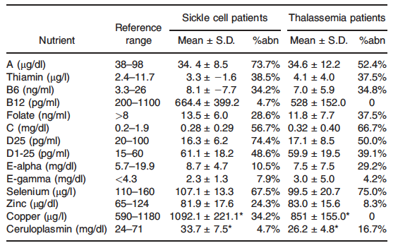
Micronutrients in Fe Loaded SCD and Thalassemia
Organ Fe is not the whole story
“Veggie Panel”
Claster S, et al . Am J Hematol. 2009; 84:344-348.
Notes:
The vitamins and trace minerals measured are listed with their normal ranges.
The patients’ mean values plus or minus the standard deviation are in the second
column. The percent of patients whose measured values fell outside the normal
range are listed as percent abnormal (third column). All abnormal values were indicative
of deficiencies with the exception of D1, 25-OH, and Cu which were elevated
in SCD. The values where there is a difference between SCD and TM
patients are indicated with a ‘‘*’’ symbol. Blood samples were drawn while patients
were fasting overnight and their usual iron chelator was held for 24 hr.
All abnormal results, with the exception of copper, represent deficiencies.

Slide 63
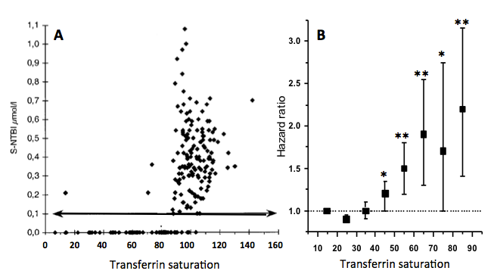
High transferrin saturation (NTBI) and early death in the general population
Sahlstedt, et al Eur J Haem 2001, 83:455
Ellervik, et al. Clin Chem. 2011;57(3):459-466
Puliyel, et al Free Rad Biol Med 2014 (in press)

Slide 64
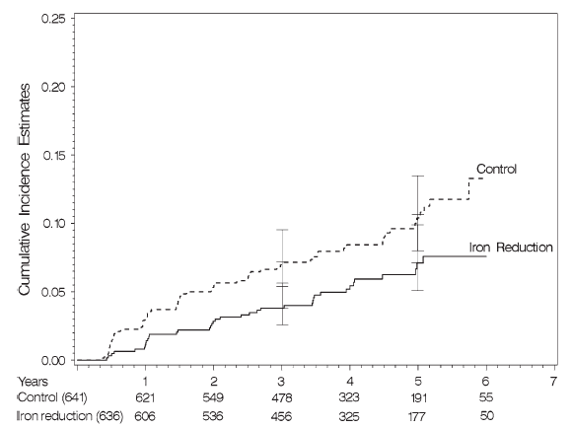
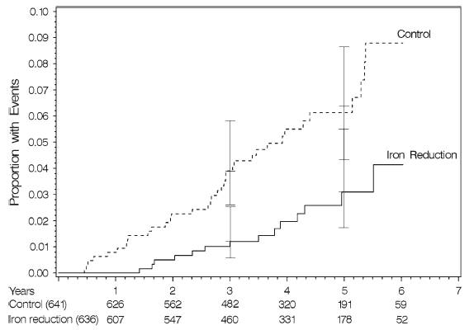
Removal of iron in older adolescent males (50 to 70 yrs) decreases cancer risk and death
1277 Men median age 67 were randomized to receive phlebotomy or not (636/641 per group) and followed for a median for 4.5 years.
Ferritin was similar in both groups to start. The ferritin was 122 in control and 79.7 in iron reduction.
All cause new cancers
Death from Cancer
30% reduction
60% reduction
P=0.019
P=0.003
Zacharski, 2008, J Natl Cancer Inst ; 100:996
Notes:
P values two sided log-rank test.

Slide 65
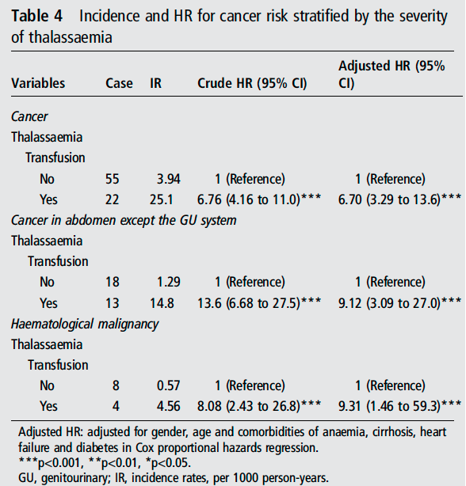
Thalassemia patients on transfusion have a much higher risk of cancer than non-transfused patients
Chung et al, Apr 2015 J Epidemiol Community Health 0:1-5
Notes:
Methods We investigated the incidence and risk of cancer in 2655 patients diagnosed with thalassaemia between 1998 and 2010 by using data from the Taiwan Longitudinal Health Insurance Database. The comparison cohort comprised 10,620 people from the general population without thalassaemia.

Slide 66
Iron Induced Cardiac Disease in Patients with Thalassemia Major - Main Cause of Death in Patients in the UK up to 1999
71% reduction
Modell. J Cardiovasc MR 2008: 42
Notes:
In 1999, T2* CMR was introduced in the UK, and doctors caring for thalassemia patients were informed of the high cardiac death rate and new options for iron chelation therapy. There has been a 71% reduction in the annualized death-rate from iron overload since 2000.
Canadian physicians are well-aware of data from around the world showing increased survival of patients treated with deferiprone, and all of the major U.S. centers have sought deferiprone access through compassionate use for patients who have failed other strategies.

Slide 67
Going for a bone marrow transplant?
If your LIC is elevated-watch out. Data evolving to suggest serious problems during and after transplant form iron related hepatic and other complications
LIC not in the toxic range or iron saturation normal? You or your child can still experience severe iron related complications in transplant
Consider having your transplant organization speak to an iron or DBA expert prior to transplant

Slide 68
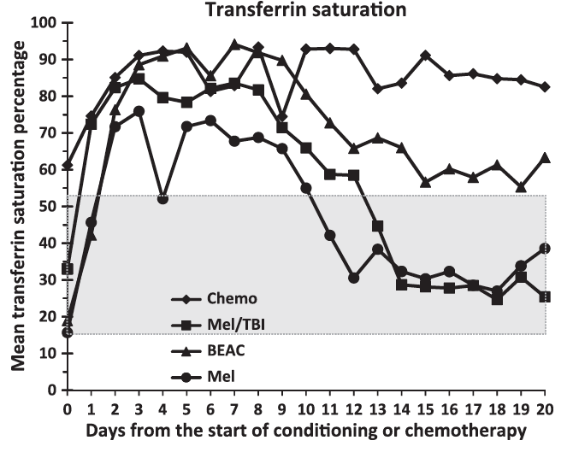
NTBI rises immediately after marrow suppression in marrow transplant
1.1
1
0.9
0.8
0.7
0.6
NTBI (μmol/L)
0.5
0.4
0.3
0.2
0.1
0
You do not need to be iron loaded to develop significant elevations of toxic LPI
0
20
40
60
80
100
120
140
160
Transferrin saturation
Sahlstedt L, et al. Br J Haematol. 2001;113:836-8
Sahlstedt L, et al. Eur J Haematol. 2009; 83:455-9
NTBI = non-transferrin-bound iron.
Notes:
68
The occurrence of NTBI in 10 adult allogeneic stem cell transplantation (SCT) patients was followed for 20 d. The transferrin saturation reached 99% on d -4 and remained > 80% thereafter. NTBI, measured as bleomycin-detectable iron, was detected for 6-18 d in all patients with a peak on d -4. High transferrin saturation levels were associated with the appearance of NTBI with a threshold at 80% saturation.

Slide 69
Summary

Slide 70
So in our opinion:
Ferritin by itself is TOTALLY inadequate for the diagnosis and monitoring of transfusional iron overload but remains a useful adjunct to routine assessment of LIC. We get ferritin with every transfusion *.
Routine assessment of LIC and cardiac fe by T2* is a critical for proper management of patient with iron overload. We do this every 12 to 18 months.
With adequate monitoring, the ideal goal for treatment should be normalization of LIC (LIC < 1.5 mg/g dw) but it would be great if the LIC were < 3.5 mg/g. Note: it can be dangerous to try to normalize iron without excellent monitoring and expertise.
A cardiac T2* > 30 ms is perfect, > 20 ms is really good.
It is critical to monitor endocrine function and other organ functions as well as micronutrient status in iron loaded patients.
* we also check transferrin saturation, but this not really helpful in management of chronic iron overload.

Slide 71
Iron loading and damage is not the same in all tissues
Organ damage = (tissue iron) x (TIME) x (environment) x (genetic factors)
It usually takes years (3 to 10 years) to have measurable damage to an organ, even if the iron in that organ is high.
Removing free iron (NTBI) from the blood can significantly improve heart failure and rhythm problems in a few weeks, long before you can get iron out of the heart itself.
High iron over many (30-40 years) may cause cancer.
The good news is, survival is increasing, in part because we are preventing early death from iron. The bad new is, long survival means prolonged exposure to toxic iron with different types of problems.
So, if we can safely control iron, lets do it!!

Slide 72
Does treating iron overload help patients?
(YES !!)
Since patients are surviving longer, we need to think about effects of decades of iron exposure as well as short term toxicity.

Slide 74
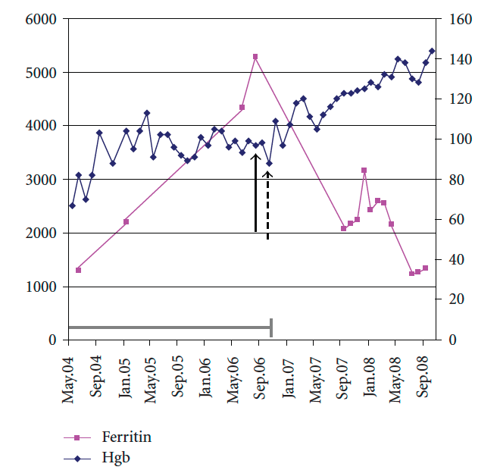
Iron restricted erythropoiesis in myelodysplastic syndrome (MDS)
Iron Chelation in MDS
Decrease in transfusion requirement in 64% of patients
Increase in pre-transfusion hemoglobin levels in 73%
Transfusion independent in 45%
Increase in platelets in 64%
Increase in neutrophil counts in 78%
Iron can poison the marrow. There have been reports of recovery in CDA and aplastic anemia with chelation.
Jensen,, Br. J. Hematology 94:288 (1996)
Badawi, Adv. Hematology 2010: 164045 (2010)

Slide 75
Measuring LIC with biomagnetic liver susceptometry (SQUID)
Advantages | Disadvantages
May be repeated frequently | Indirect measurement of LIC
Allows follow-up | Limited availability
 | High cost
 | Highly specialized equipment requiring dedicated technician
 | Not validated for LIC assessment and may underestimate levels compared with biopsy*
*During clinical development of deferasirox, LIC data by biopsy were shown to be related to data by SQUID by a factor of 0.46
SQUID, Superconducting QUantum Interference Device
Piga A et al. Presented at ASH 2005 [Blood 2005;106(11):abst 2689]
Notes:
Superconducting Quantum Interference Device (SQUID) assessment provides a linear correlation with LIC from biopsy and, being non-invasive, can be repeated frequently and allows patient follow-up.
However, it is an unvalidated method providing an indirect measure of LIC, and cannot be used to assess cardiac iron levels. In addition, the availability of SQUID machines is limited (only four worldwide), and it is an expensive technique requiring specialized equipment and technicians.
SQUID may underestimate LIC assessment by a factor of two compared with biopsy.¹ As wet-to-dry weight conversion calculations may differ, it is recommended that the same technique for measuring iron is used consistently in individual patients.
Reference
Piga A et al. Blood 2005;106(11):abst 2689.

Slide 76
LVEF monitoring as a predictor of high risk
1.00
LVEF normal (n=47)
LVEF decrease of >10% or to below 45% results in significant increase in risk of:
Cardiac failure (P<0.001)
Cardiac death (P=0.001)
0.75
LVEF falls (n=34)
0.50
Survival probability
27/27 alive, if comply
7/7 dead, if poor intensification
0.25
0
0
5
10
15
20
Follow-up (years)
Davis BA et al. Blood 2004:104:263–269
Notes:
This study evaluated survival in 81 patients with thalassemia major receiving DFO therapy (30–50 mg/kg, 8–12 hours/day, 5–7 days/week). LVEF was monitored yearly by multigated acquisition between 1981 and 2001.
DFO treatment was intensified in the event of objective evidence of asymptomatic left ventricular dysfunction (ie fall in LVEF >10% or to below the reference range of 45%) to prevent progression to congestive heart failure. Patients were categorized into two groups, those with resting LVEF <45% or >10% drop (category 1) and those with resting LVEF >45% (category 2).
When survival was compared according to LVEF, all deaths (n=7) occurred among category 1 patients, ie those with demonstrable LV dysfunction. A LVEF <45% or a decrease >10% was significantly associated with the development of symptomatic cardiac disease (chi-square test, P<0.001) and death (Fisher’s exact test, P=0.001).
These results demonstrate the value of monitoring LVEF for patient outcome, showing that a decrease in LVEF of >10% or an absolute value <45% was associated with progression to clinical heart failure within a median of 3.5 years.
Reference
Davis BA et al. Blood 2004:104:263–269.

Slide 77
Properties of an ideal chelator
Efficacy
Maintenance of iron balance or achievement of negative iron balance
High and specific affinity for ferric iron (Fe³⁺)
Effective tissue and cell penetration
High-chelating efficiency
No iron redistribution
Slow metabolism and elimination rate
24-hour chelation coverage
Convenience
Oral bioavailability
Half-life compatible with once-daily dosing
Good compliance
Tolerability
Good adverse event (AE) profile
Notes:
There are a number of key properties that an ‘ideal’ iron chelator should possess.
The main properties are a high degree of affinity for iron and concomitantly a low affinity and specificity for other physiologically important metals (eg copper and zinc). The chelator should be able to chelate a large quantity of iron, thereby avoiding the need for large doses.
An ideal chelator should also have a half-life compatible with once-daily dosing and 24-hour chelation coverage.
Other desirable characteristics are the ability to penetrate cells and tissues to remove iron from any tissue in which it is stored.
Oral bioavailability is also important as this avoids the expense and inconvenience of parenterally administered therapy.
Finally, the drug should also be relatively well-tolerated so that treatment is not limited by toxicity.

Slide 78
Chelating agents
DFO
Indicated for the treatment of chronic iron overload in patients with transfusion-dependent anemias¹
Deferiprone
Treatment of iron overload in patients with thalassemia major for whom DFO therapy is contraindicated or inadequate.² Only limited data are available for pediatric patients aged 6–10 years and no data for patients <6 years
Deferasirox
Treatment of iron overload due to blood transfusions in adults and children aged 2 years and older³ (Please substitute with regional prescribing information where slide is being presented)
¹Desferal® Prescribing Information. Novartis 2007; ²Ferriprox® [package insert]. Apotex Europe Ltd 2004; ³EXJADE® (deferasirox) Basic Prescribing Information. Novartis Pharma AG
Notes:
DFO is indicated for the treatment of acute iron intoxication and of chronic iron overload due to transfusion-dependent anemias. Iron mobilization with DFO is relatively poor in patients under the age of 3 years with relatively little iron overload. The drug should ordinarily not be given to such patients unless significant iron mobilization (eg 1 mg or more of iron per day) can be demonstrated.¹
Deferiprone is indicated for the treatment of iron overload in patients with thalassemia major for whom DFO therapy is contraindicated or inadequate.² Only limited data are available for pediatric patients aged 6–10 years and no data for patients <6 years.
Deferasirox is indicated for the treatment of chronic iron overload due to blood transfusions (transfusional hemosiderosis) in patients 2 years of age and older.³ This is the Deferasirox Basic Prescribing Information indication; national Prescribing Information should be followed.
References
Desferal® Prescribing Information. Novartis 2007.
Ferriprox® [package insert]. Apotex Europe Ltd 2004.
EXJADE® (deferasirox) Basic Prescribing Information. Novartis Pharma AG. National Prescribing Information should be followed.

Slide 79
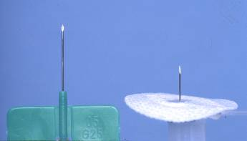
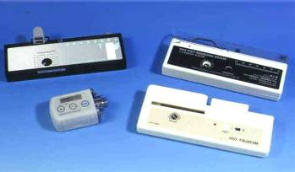
Limitations of DFO therapy
Poor oral bioavailability and a short plasma half-life
Slow subcutaneous infusion 3–7 times weekly
Inconvenient administration
Injection-site reactions and pain
Poor compliance reported to lead to increased mortality¹
Equipment not widely available in many countries
¹Gabutti V & Piga A. Acta Haematol 1996;95:26–36
Notes:
Treatment with DFO is demanding. The drug has poor oral bioavailability and a short plasma half-life. Therefore, slow subcutaneous infusions are necessary 3 to 7 times weekly. Because of injection-site reactions and pain, the administration is inconvenient, and equipment is not available in many countries. These factors lead to poor compliance, which in turn leads to increased mortality.

Slide 80
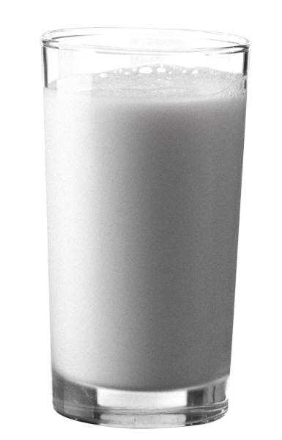
Possible chelation regimens
Deferasirox monotherapy
MON
TUE
WED
THU
FRI
SAT
SUN
100% chelation coverage
Continuous chelation coverage with once-daily oral deferasirox
Notes:
Once-daily dosing with deferasirox provides continuous chelation coverage.

Slide 81
Protection from LPI appearance with standard chelation regimens
1.2
Deferiprone x3
1.2
--DFO--
1.0
1.0
0.8
0.8
LPI (µmol/l)
0.6
0.6
Deferiprone (75 mg/kg/day
orally in three daily doses)
DFO (40 mg/kg/day overnight)
Deferasirox (30 mg/kg/day once daily)
The grey shaded area denotes the normal range of LPI
0.4
0.4
0.2
0.2
0
0
2
4
6
8
10
12
24
0
0
2
4
6
8
10
12
24
1.2
Deferiprone x3
--DFO--
1.2
Deferasirox
1.0
1.0
0.8
0.8
0.6
LPI (µmol/l)
0.6
0.4
0.4
0.2
0.2
0
0
2
4
6
8
10
12
24
0
0
2
4
6
8
10
12
24
Treatment (h)
Treatment (h)
LPI values were determined in blood samples taken every 2 hours, starting at 8am
(0 hours)until 8–10pm and ending at 8am the following day (24 hours)
Zanninelli G et al. Br J Haematol 2009;147:744–751
Notes:
Periodic monitoring of LPI over a 24 hour time-span was used to compare the ability of chelation to control daily LPI levels in 40 thalassemia major patients who had been receiving one of three different chelation protocols for more than a year:¹
Group I: DFO overnight
Group II: deferiprone daily
Group III: DFO and deferiprone sequentially.
An additional group (Group IV) was treated with deferasirox for up to 6 months.
The patterns of daily LPI recrudescence showed significant individual variations, especially in patients treated with DFO or deferiprone, although these patterns were maintained over 6–9 months of treatment in all groups.
Group data analysis showed that the proportion of patients whose daily LPI were maintained within the normal range (<0.45 μmol/L) varied with treatment: 6/10 with DFO, 5/11 with deferiprone, 9/10 with DFO + deferiprone and 8/10 at the onset and 10/10 after 6 months treatment with deferasirox.
Reference
1. Zanninelli G et al. Br J Haematol 2009;147:744–751.

Slide 82
Iron in the liver and chelation therapy
Levels >7 mg Fe/g dw associated with increased risk of hepatic fibrosis and diabetes mellitus
Normal liver iron levels are <1.2 mg Fe/g dw
Levels >15 mg Fe/g dw associated with greatly increased risk of cardiac disease and death in unchelated patients
Optimal maintenance level for chelation therapy in patients with thal major is <7 mg Fe/g dw
The liver is the primary site of iron storage in the body
Chelation therapy effectively maintains / reduces liver iron levels
Iron overload can be monitored by measuring LIC
LIC correlates significantly with total body iron stores
Notes:
The liver is the primary site of iron storage in the body.
Iron overload can be monitored by measuring LIC, which correlates significantly with total body iron stores.
Normal liver iron levels are <1.2 mg Fe/g dw:¹
Levels >7 mg Fe/g dw associated with increased risk of hepatic fibrosis and diabetes mellitus.
Levels >15 mg Fe/g dw associated with greatly increased risk of cardiac disease and death.
Chelation therapy effectively maintains/reduces liver iron levels:
An optimal maintenance level for chelation therapy in patients with thalassemia is <7 mg Fe/g dw.
Reference
Olivieri NF & Brittenham GM. Blood 1997;89:739–761.

Slide 83
When does cardiac iron loading begin?
>13 years of transfusions
>35 grams
Data only for patients with thalassemia major receiving chelation
Prior chelation therapy
Sickle cell
Thalassemia
70
60
50
40
T2*
30
20
Abnormal T2*
10
0
0
5
10
15
20
25
Transfusion (years)
Wood JC et al. Blood 2004;103:1934–1936
Notes:
Wood et al. measured cardiac T2* in 19 patients with thalassemia major and 17 patients with SCD. Both patient groups had received prior chelation therapy.
Patients with SCD were predominantly receiving transfusions for less than 13 years (13 of 17), whereas the majority of patients with thalassemia (10 of 19) had transfusions for longer periods.
Cardiac T2* was normal in all of the patients with SCD but was low (high iron) in 8 of 19 patients with thalassemia major.
Cardiac T2* was negatively correlated with transfusion duration for thalassemia major but not SCD (thalassemia major, R²=0.56, P=0.002).
Abnormal T2* was observed only in the patients with thalassemia major receiving transfusions for ≥13 years and was correlated with serum ferritin but not liver iron levels.
Reference
Wood JC et al. Blood 2004;103:1934–1936.

Slide 84
Continuous, 24-hour DFO therapy improves cardiac T2* and cardiac function
Six subjects showed improved cardiac T2*
Baseline
12 months
70
120
P=0.03
108
P=0.02
9
P=0.003
110
106
8
P=0.03
100
104
7
90
102
6
60
100
80
5
%
mL
g
98
ms
70
4
60
P=0.02
96
50
94
3
50
40
92
2
30
90
1
40
20
88
0
LVEF
LVEDVI
LVESVI
LV mass index
Cardiac T2*
LVEDVI = left ventricular end-diastolic volume index; LVESVI = left ventricular end-systolic volume index
Anderson LJ et al. Br J Haematol 2004;127:348–355
Notes:
This study evaluated the effect of iv DFO on cardiac parameters over a 1-year period in patients with heart failure; iv DFO is the only indicated and proven treatment for the reversal of iron-related cardiac complications.
There was a progressive and significant improvement in LVEF, although only three of six patients had entered the normal range for thalassemia. In line, with the improvement in LVEF, there were also progressive significant improvements in left ventricular volumes.
The improvements in cardiac function were shown to correlate with an increase in cardiac T2*, highlighting the value of this technique.
However, the rate of improvement was slow compared with the removal of LIC, showing that the rate of iron clearance with DFO was significantly faster from the liver than from the heart. Patients with heart failure should therefore not be managed using the measurement of liver iron only; measurement of cardiac T2* and ventricular function are also important parameters.
Reference
Anderson LJ et al. Br J Haematol 2004;127:348–355.

Slide 85
All available chelators remove cardiac iron
Liver iron and heart iron do not correlate after chelation is started
Effect of chelation therapy on cardiac iron
 | DFO¹ | Deferiprone¹ | Deferasirox^{2,3}
Improvement in T2* | ✓ | ✓ | ✓
Increase in LVEF | ✓ | ✓ | ✓ (for patients with T2* >20 ms)
Reversal of cardiac dysfunction (symptomatic or asymptomatic) | ✓ | ✓ | No data yet
¹Pennell DJ et al. Blood 2006;107:3738–3744; ²Pennell DJ et al. Blood 2010;115:2364–2371; ³Pennell DJ et al. Blood 2009;114(22):abst 4062

Slide 86
Toxic radical formation increases with higher levels of ‘free’ iron in cells
NTBI appears when transferrin iron-binding capacity is exceeded:
Redox-active component is labile plasma iron (LPI), which is chelatable and prevalent at >70% transferrin saturation
LPI is potentially toxic:
Enters cells via unregulated pathways
Raises LCI, producing a labile iron pool
LCI can catalyze formation of noxious HO· radicals to cause reactive oxygen species (ROS)
LCI (Fe³⁺ and Fe²⁺) reacts with reactive oxygen intermediates (O₂ and H₂O₂) produced by respiration or by other incomplete reductions of O₂ and forms noxious HO· radicals (Haber-Weiss cycle)
Fe³⁺ + O₂ → Fe²⁺ + O₂
Fe²⁺ + H₂O₂ → Fe³⁺ + OH– + HO· (Fenton reaction)
Sustained levels of LCI cause persistent oxidative stress
Notes:
Labile plasma iron (LPI) or ‘free iron’, a directly chelatable component of NTBI, is highly toxic as it can catalyze the formation of harmful free hydroxyl radicals.
LPI is thought to be the iron that loads cells via a mechanism other than the transferrin receptor. Current opinion is that this uptake is unregulated. A calcium ion channel has been hypothesized as the route of entry.
LPI is detected in patients with transfusional iron overload.

Slide 87
Correlation between serum ferritin and LIC in various underlying anemias
MDS
DBA
Other anemias
β-thalassemia
Regression line
15
10
5
Change in LIC (mg Fe/g dw per year)
0
−5
−10
−15
−2000
−1500
−1000
−500
0
500
1000
1500
2000
2500
3000
Change in serum ferritin (ng/mL per year)
Porter J et al. Eur J Hematol 2008;80:168–176
Notes:
In a study of deferasirox in patients with MDS (n=47), DBA (n=30), other rare anemias (n=22) or β-thalassemia (n=85), a correlation was observed between changes in serum ferritin and LIC, which was consistent across disease groups (R=0.59, P<0.001).¹
As LIC has been shown to accurately predict total body iron levels, these findings support the use of regular serum ferritin assessments for the monitoring of iron chelation therapy.
Reference
Porter J et al. Eur J Hematol 2008;80:168–176.

Slide 88
R2 measurements correlate with liver biopsy iron concentration
Both R2* and R2 calibrations appear to have similar calibrations in SCD and thalassaemia
Hepatitis
Haemochromatosis
β-Thalassaemia/HbE
β-Thalassaemia
MRI Measurement error 5-8%
350
300
r = 0.98
300
250
p < 0.0001
250
n = 105
200
200
R2 (Hz)
(R2) (s⁻¹)
150
150
LIC by R2*, R = 0.96
St Pierre calibration
Biopsy–LIC, R = 0.97
Controls
100
100
50
50
0
0
0
10
20
30
40
50
0
10
20
30
40
50
Biopsy iron concentration (mg Fe/g dry wt)
Estimated LIC (mg Fe/g dry wt)
St Pierre TG, et al. Blood. 2005;105:855-61.
Wood JC, et al. Blood. 2005;106:1460-5.

Slide 89
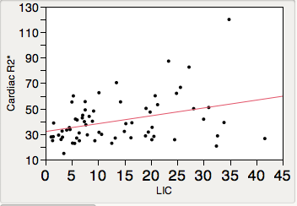
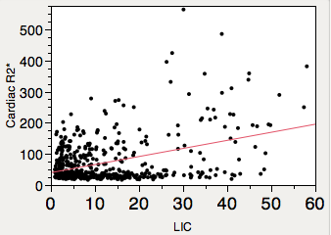
Cardiac Fe is only vaguely related to LIC
DBA
TM
While cardiac iron tends to go up when LIC is high for a while, you cannot really predict cardiac iron from LIC. You need to measure it directly.
r² = 0.19 β=2.5 p < .01
r² = 0.1 β=.06 p < .001

